Slide 1
Leonardo 4 Children 2023
Climate, Equality & Peace

Slide 2
Leonardo 4 Children
In partnership with:

Slide 3
Leonardo 4 Children
Every child is an artist
(Pablo Picasso)
Every child can be a genius
(Leonardo 4 Children slogan)

Slide 4
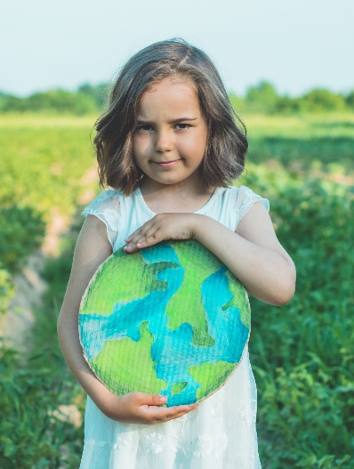
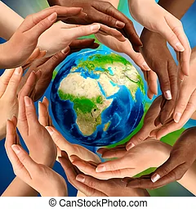
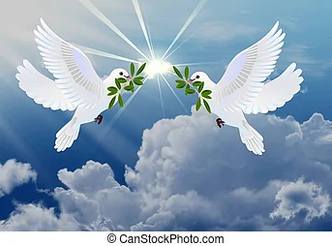
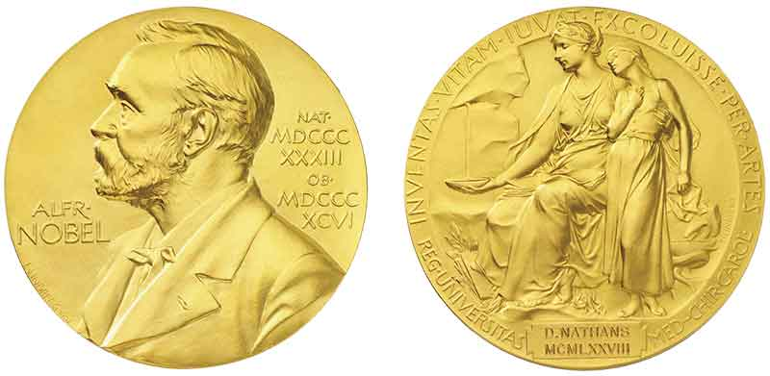
Leonardo 4 Children
What is Leonardo 4 Children ?
A non-profit initiative to stimulate children on global issues such as Climate Action, Equality and Peace, and to support children in need with education in Art and Science.
A kind of "Nobel Prize" for Children and Teenagers? Why not?!

Slide 5
Leonardo 4 Children
Outline
2019 edition on Leonardo da Vinci
2020 edition on Climate Action
2021 edition on Climate Action & Gender Equality
2022 edition on Climate, Equality and Peace
Awards: more than 1,900 participants with 660 works from 16 EU countries and 5 countries outside EU
13 events more than 4,500 participants
“Leonardo 4 Children” publications: 3,000 copies distributed
Beneficiary projects: Jordan, Kenya, Ukraine, Kyrgyzstan, Italy, Ivory Coast

Slide 6
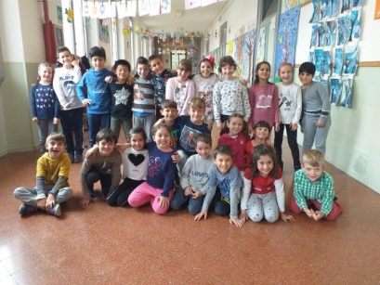
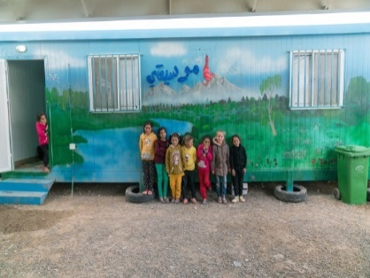
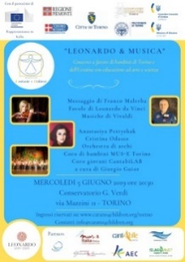
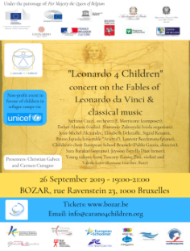
Leonardo 4 Children Community
Art & Science
Awards
Solidarity
Events & Publications

Slide 7
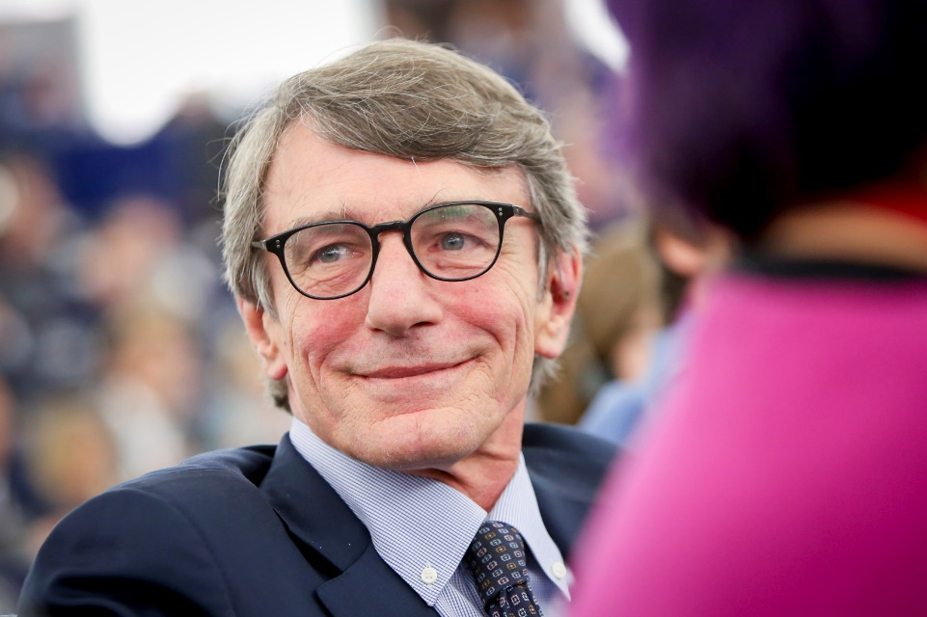
In memory of
“I welcome the initiative Leonardo 4 Children and I am pleased that the European Parliament has decided to give its patronage to the workshop on climate action and gender equality planned on 1 October 2021. I encourage all children and young people to take part in the initiative and use art and science skills to provide their ideas in order to solve these fundamental issues and become responsible and empowered European leaders of the future.”
David Sassoli, President, European Parliament

Slide 8
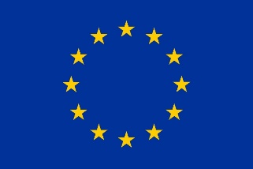
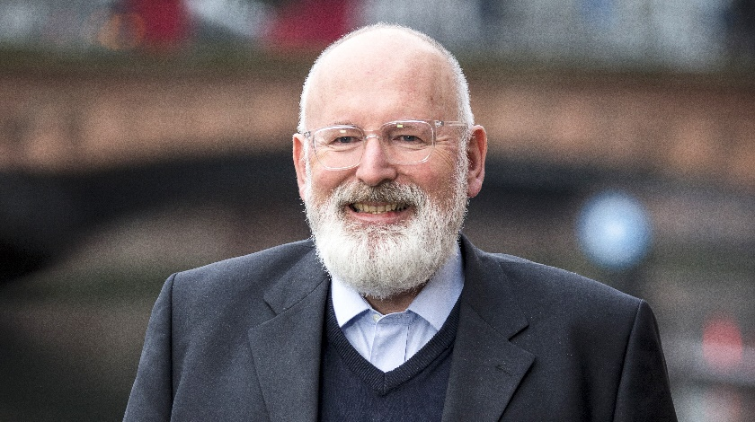
Testimonials
“Children and young Europeans are at the heart of the Green Deal. There would not be a Green Deal without the demand for action from young people all across Europe. Our fight against the climate and biodiversity crises is to ensure that our children and grandchildren can still live happy and healthy lives on this planet. And after they have shown incredible solidarity with older generations during the pandemic, it is time we repay that by showing solidarity with their future. This year’s winners of Leonardo for Children have sent in beautiful and inspiring creations that provide plenty of ideas for what my generation can do for the climate and environment, and how we can do it in a way that supports gender equality.”
Frans Timmermans, Executive Vice-President European Commission
EU Climate Pact
EU Climate Ambassadors
https://europa.eu/climate-pact/index_en

Slide 9
Leonardo 4 Children 2023 Awards
Talent Development Programme
For children and teenagers resident in European Union + open to global regions (min 100 participants) with partners
Works by children can be donated for beneficiary projects
3 categories:
Fables by children aged 6-12
Art & Science by teenagers aged 13-18
Music by composers aged 16-30

Slide 10
Leonardo 4 Children
Climate, Equality & Peace
Topic: “Climate”
To interpret the issue of climate change and environmental sustainability, addressing the problem and possibly proposing a creative solution, for example on:
energy production;
energy consumption;
transport;
water;
agriculture and food;
natural environment and biodiversity;
waste and recycling.

Slide 11
Leonardo 4 Children
Climate, Equality & Peace
Topic: “Equality”
To interpret the issue of equality between people, addressing the problem and possibly proposing a creative solution, for example on:
promoting non-discrimination and social inclusion, fighting social stereotypes;
promoting gender equality, fighting gender stereotypes;
promoting income equality, fighting poverty.
Topic: “Peace”
To interpret the issue of peace between people, addressing the problem and possibly proposing a creative solution to fight and/or prevent conflicts, for example on:
peace among family members and friends;
peace among social, political, ethnic, economic groups;
peace among people, nations, regions.

Slide 12
Award Fables for children aged 6-12
Open from November 2022 to 31 May 2023
The Award allows children to use their creativity and their artistic and scientific skills to:
Create an original fable on climate, equality or peace of max 200 words with a “morale” at the end
Illustrate it with comic strip of 2-10 frames with at least 2 colors OR interpret with music, dance or theatre performance
Bonus for multicultural and teamwork

Slide 13
Award Fables for children aged 6-12
Scoring criteria
Ability to address the issue of climate change, equality and/or peace
Creativity and originality
Quality of illustration and visual impact
Number of frames
Work is part of a class / team activity

Slide 14
Award Fables for children aged 6-12
Awards
The authors of the works with the 10 best scoring will receive an award, consisting in:
talent development programme, with a budget for each winner of € 300 (top 3 winners) / € 200 (4th-10th winner) to develop their skills in art & science, for instance with workshops, courses, meeting with experts, visits and material;
publication on “Leonardo 4 Children” book used or raising funds and as donation to children in need;
presentation at workshop and award ceremony; promotion on website, social media and promotional material, at public events, institutions or public places including famous museums, and during concerts and events;
“Leonardo 4 Children” award certificate.

Slide 15
Award Art & Science for teenagers aged 13-18
Open from November 2022 to 31 May 2023
The Award allows teenagers to use their creativity and their artistic and scientific skills to create an original work integrating
one artistic topic (eg music, dance, sculpture, drawing, painting) and
one scientific topic (eg energy, transport, aeronautics, biology, ICT)
on climate, equality or peace, addressing the issue and possibly proposing a solution.

Slide 16
Award Art & Science for teenagers aged 13-18
The work should:
be made in physical material or multimedia/digital means (picture, video), and can consist of: drawing or painting; novel, story or poem; music or dance performance; handicraft or sculpture; project design or any other creative work;
be inspiring for people;
be completely original and not contain any third party’s work;
be possibly done by participating children in a team and in the context of a class activity
Winning works can become interactive games.

Slide 17
Award Art & Science for teenagers aged 13-18
Scoring criteria
Ability to address the issue of climate change, equality and/or peace
Creativity, originality, and innovation
Ability to inspire people
Integration of art and science
Multicultural dimension and teamwork

Slide 18
Award Art & Science for teenagers aged 13-18
Awards
The authors of the works with the 10 best scoring will receive an award, consisting in:
talent development programme, with a budget for each winner of € 300 (top 3 winners) / € 200 (4th-10th winner) to develop their skills in art & science, for instance with workshops, courses, meeting with experts, visits and material;
publication on “Leonardo 4 Children” book used or raising funds and as donation to children in need;
presentation at workshop and award ceremony; promotion on website, social media and promotional material, at public events, institutions or public places including famous museums, and during concerts and events;
“Leonardo 4 Children” award certificate.

Slide 19
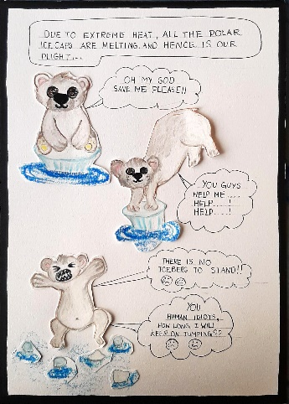
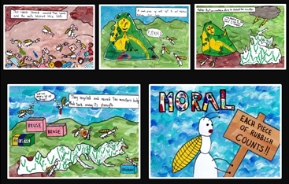
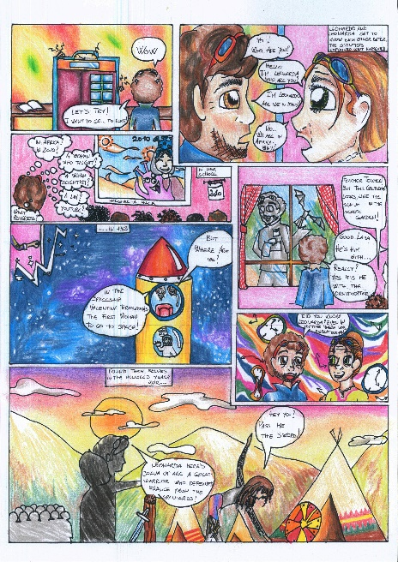
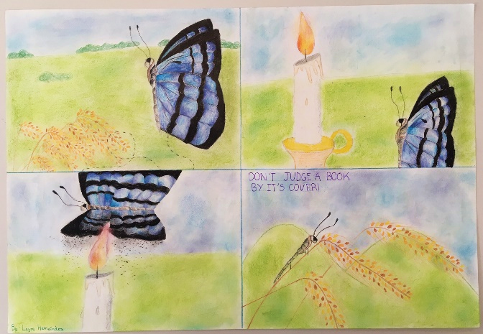
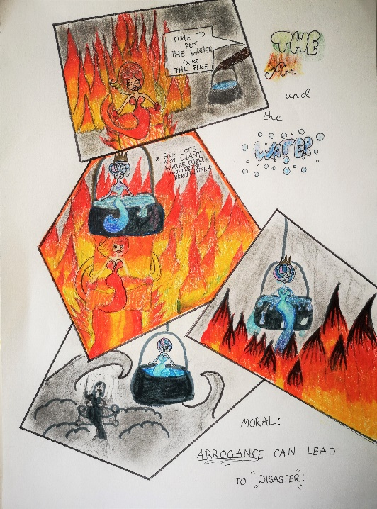
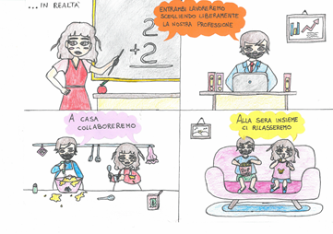
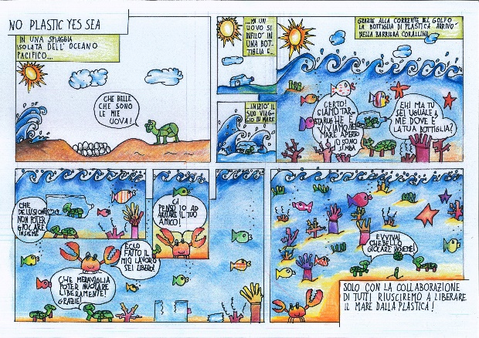
Leonardo 4 Children winners

Slide 20
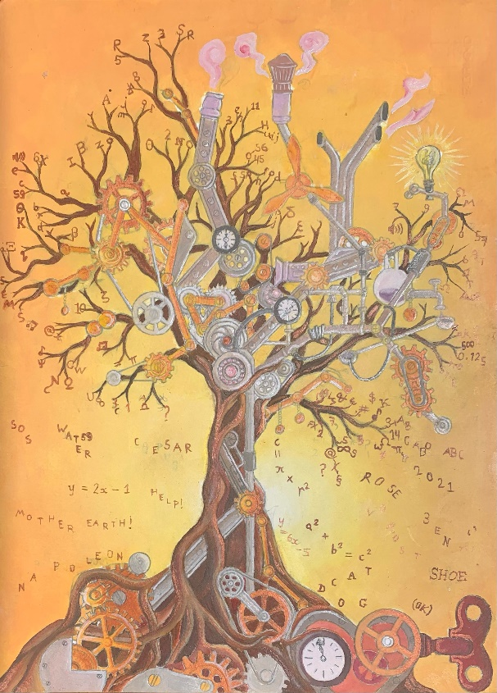
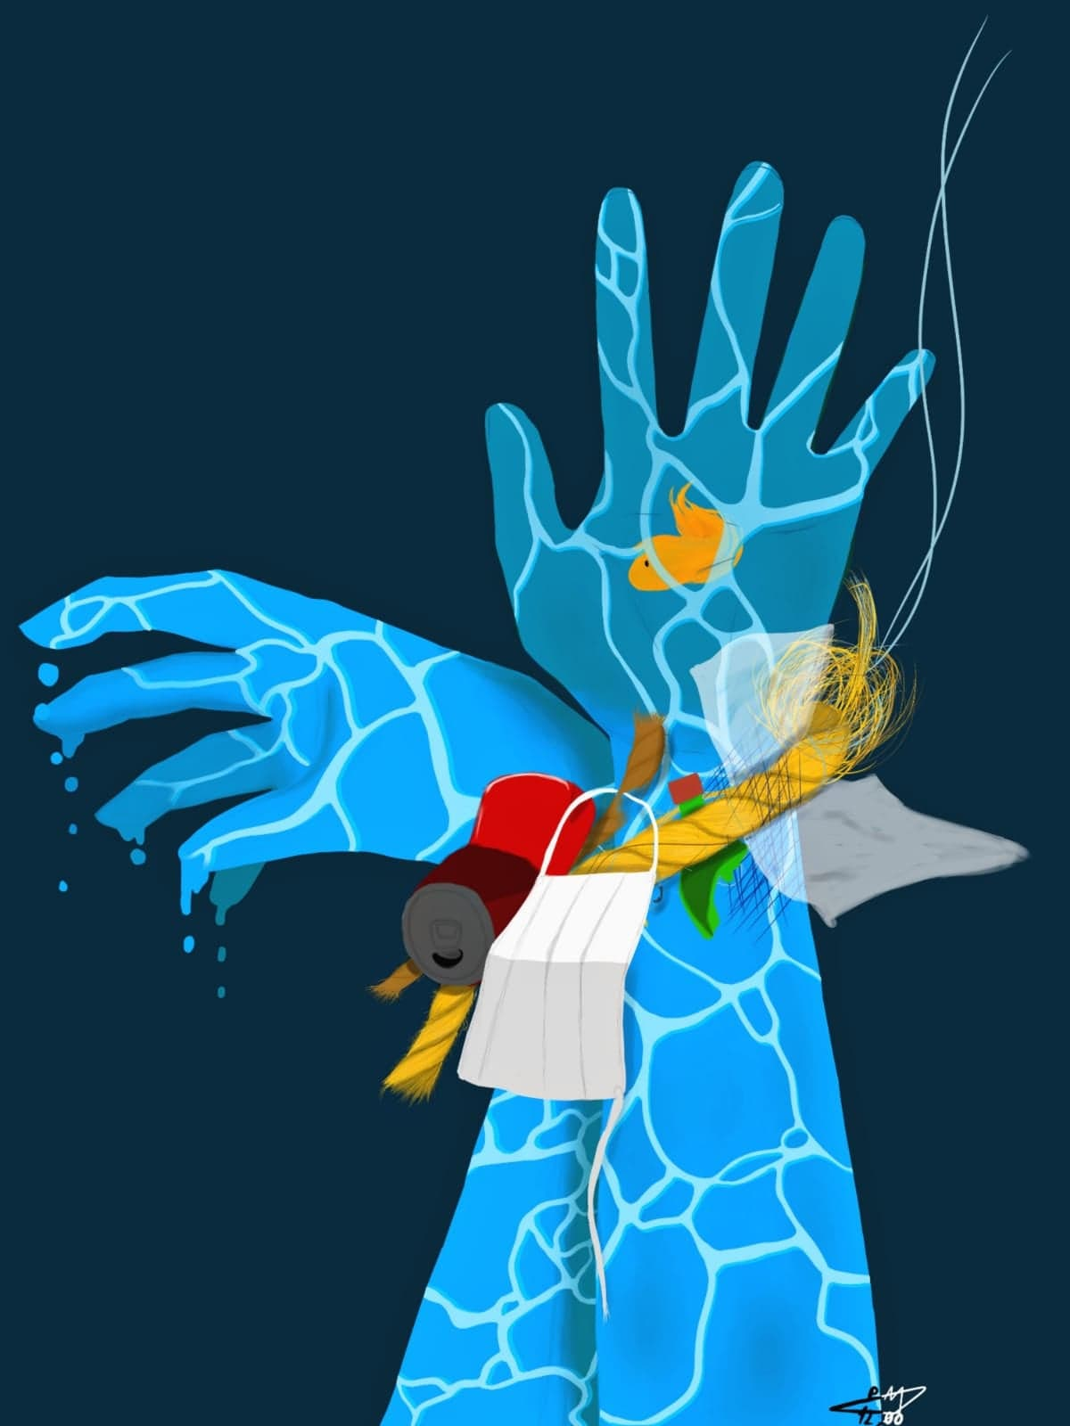
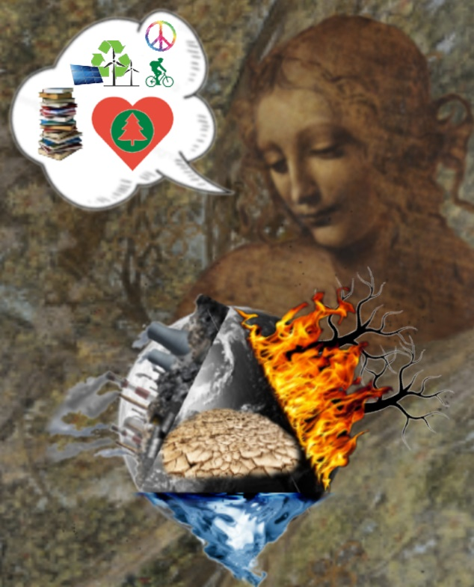
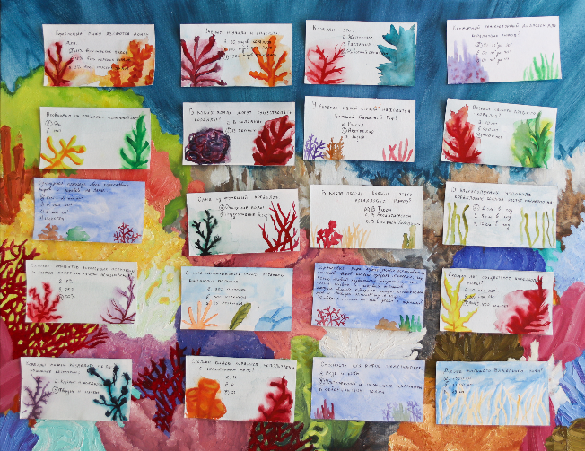
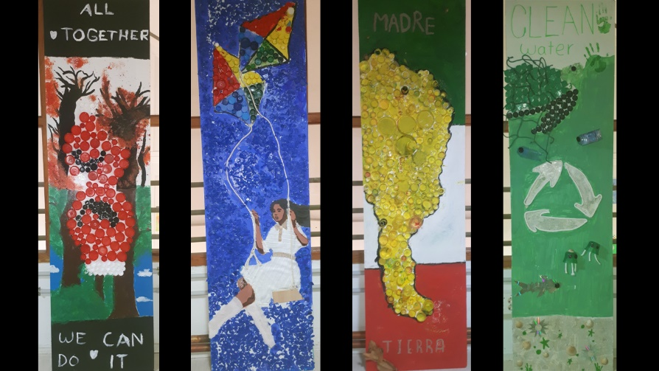
Leonardo 4 Children winners

Slide 21
Leonardo 4 Children winners
Examples of winners from previous editions
Fables
https://carano4children.org/leonardo4children-2022-fables/
https://carano4children.org/leonardo4children-2021-fables/
https://carano4children.org/leonardo4children-2020-fables
https://carano4children.org/leonardo4children-2019-fables
Art & Science
https://carano4children.org/leonardo4children-2022-artscience
https://carano4children.org/leonardo4children-2021-artscience
https://carano4children.org/leonardo4children-2020-artscience
https://carano4children.org/leonardo4children-2019-artscience

Slide 22
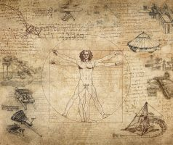
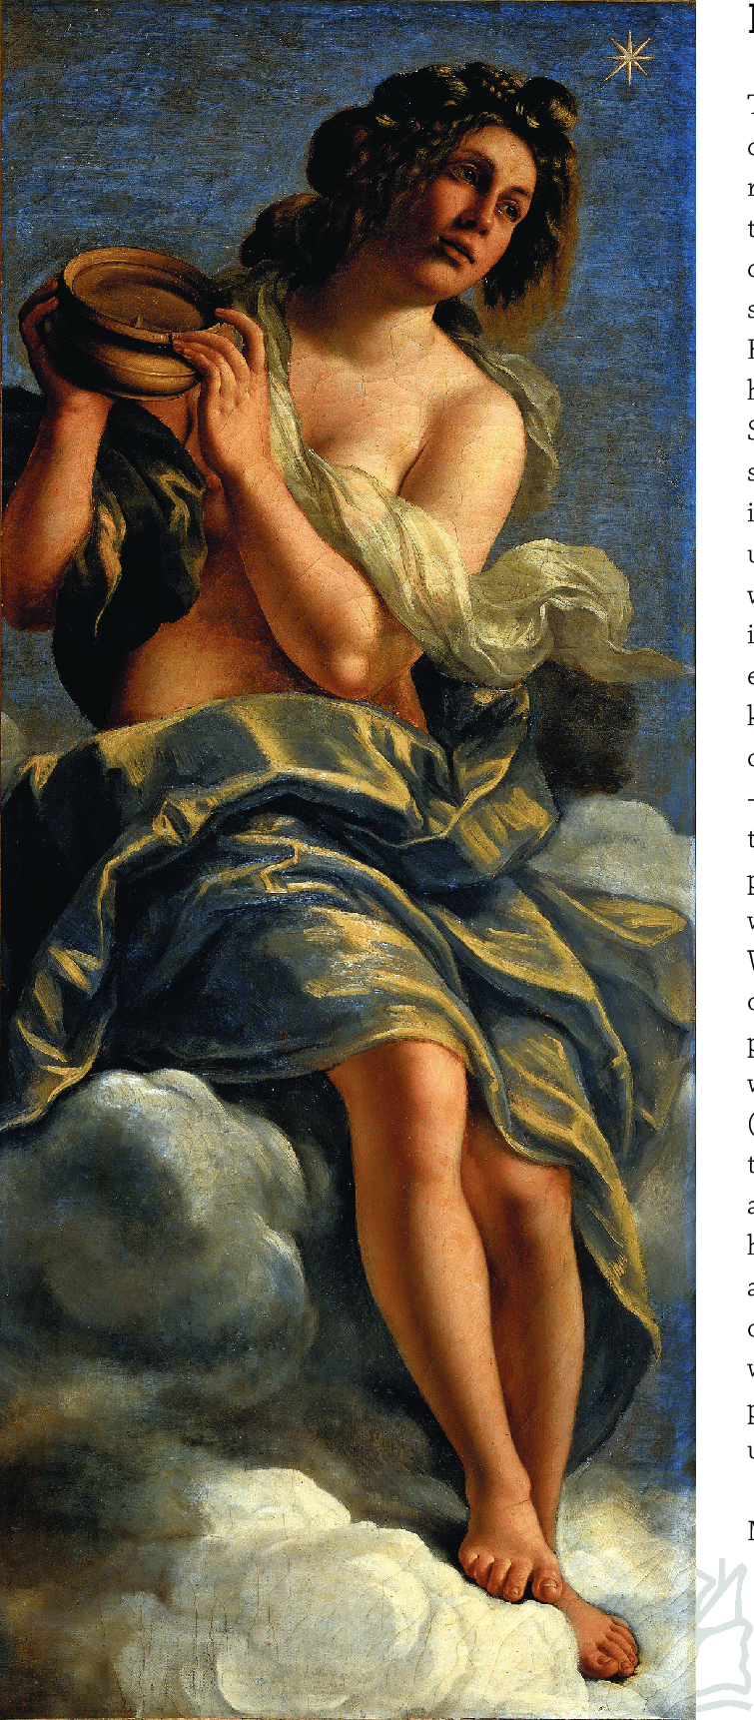
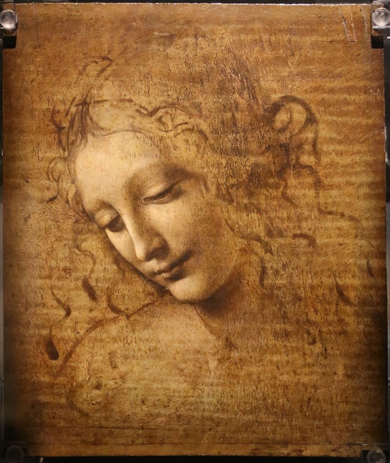
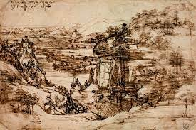
Leonardo 4 Children Preparatory work
Activities inspired by Leonardo da Vinci and Artemisia Gentileschi (by Margherita Mesirca and Nancy von Breska)
Available in annex to the Terms and Conditions

Slide 23
Award Leonardo 4 Music for composers aged 16-30
Open from December 2022 to 31 May 2023
The Award allows young composers to use their creativity and their artistic and scientific skills to create an original composition on climate, equality or peace:
Inspired on Climate, Equality & Peace by Leonardo, previous Leonardo4Children winners, or a movie scene or story (poem, fable)
Tonal music
Duration 3-10’
Using between 1 and 7 instruments
With optional voices/choirs
In partnership with

Slide 24
Award Leonardo 4 Music for composers aged 16-30
Scoring criteria
Inspiration on the selected topic of climate, equality and/or peace;
Creativity and originality;
Quality of tonal music;
Quality of vocal and choral elements, if applicable;
Alignment with Leonardo’s work or other source of inspiration (movie, story), if indicated by the applicant.

Slide 25
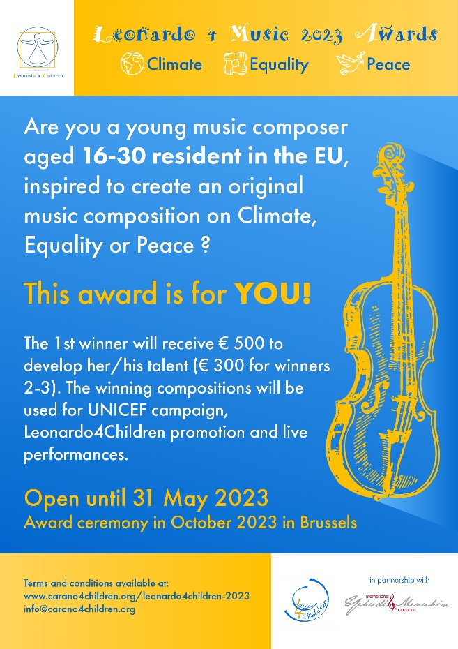
Award Leonardo 4 Music for composers aged 16-30
Awards
The winner nr 1 will be offered the opportunity to use her/his music for a promotional campaign by UNICEF and the winner nr 2 for the promotional video of Leonardo4Children initiative.
The first 3 winners will receive a talent development budget of € 500 (winner nr 1) / € 300 (winner nr 2 and 3) each to develop their music talent, including a special prize offered in memory of Italian musician “Ermanni Testi”.
Music to be played at future Leonardo 4 Children concerts and the award ceremony in prestigious locations such as BOZAR Brussels.

Slide 26
Leonardo 4 Children Awards
How to apply by 31 May 2023
Terms and conditions and Application Form available at
www.carano4children.org/leonardo4children-2023
For competitions:
Email: leonardo@carano4children.org
For general information
Email: info@carano4children.org

Slide 27
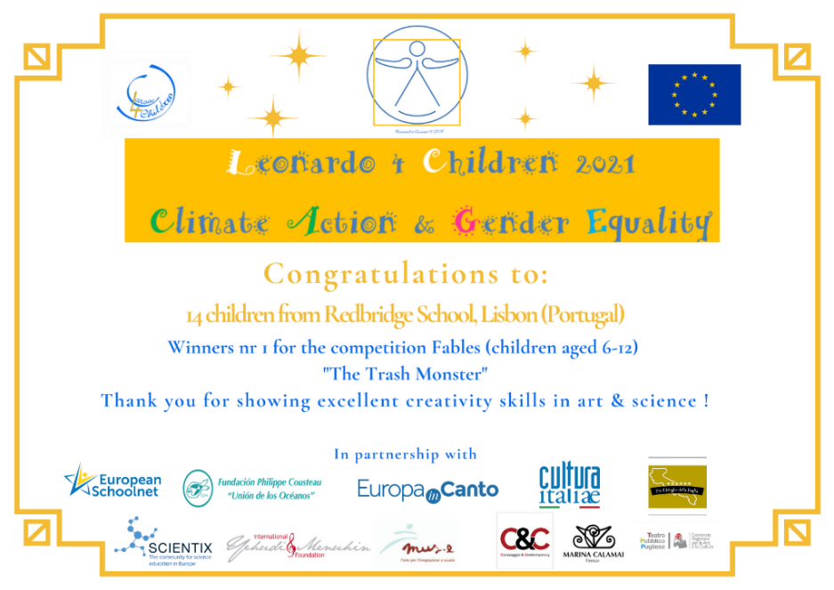
Leonardo 4 Children Awards
The 10 works with the best scoring for each competition will receive the awards:
publication on “Leonardo 4 Children” book;
presentation at workshop and award ceremony;
presentation at public events, institutions or public places including famous museums, and during concerts and events;
“Leonardo 4 Children” award certificate;
publication on website, social media and promotional material.
The foundation will seek partners and sponsors to offer special awards, which would consist in material related to art and science, or special experiences related to art and science, such as workshops, meeting with personalities and experts, toolkits, etc.

Slide 28
Leonardo 4 Children
Books available at carano4children.org/products
All net proceeds are for beneficiary projects
Publication
Recognition for winners, Education, Support to beneficiary projects
€ 10 € 15 € 10

Slide 29
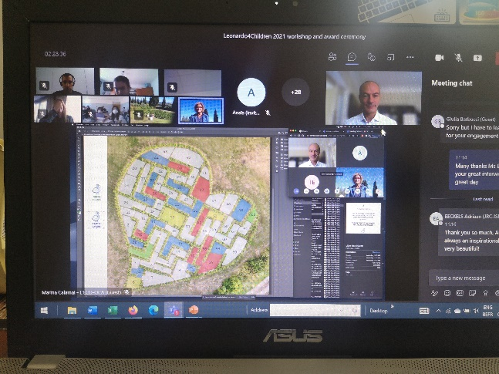
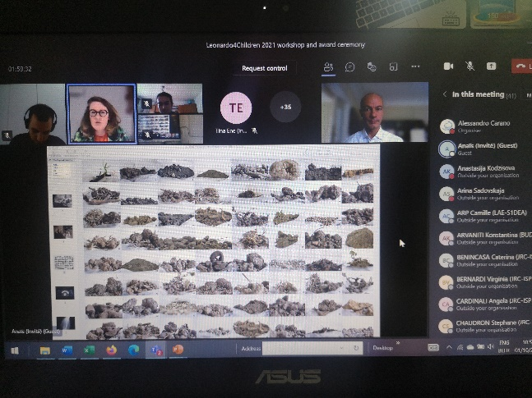
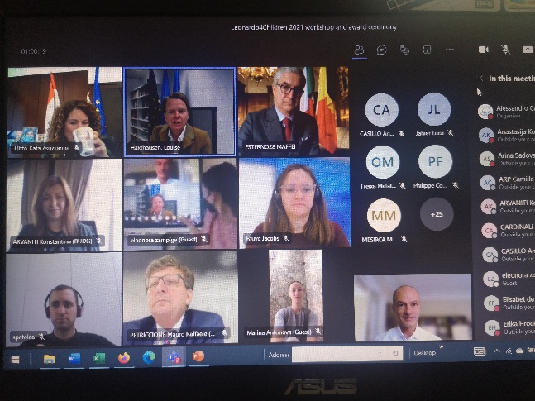
Leonardo 4 Children Workshop
Winners in particular will be invited to «twin» with other participants and take part in the Leonardo 4 Children community as ambassadors.
Workshop between participants to exchange views and present the works.

Slide 30
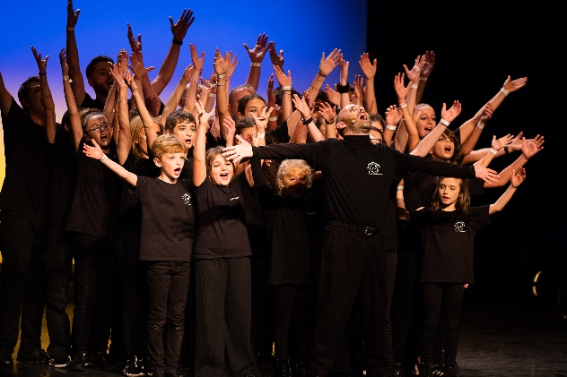
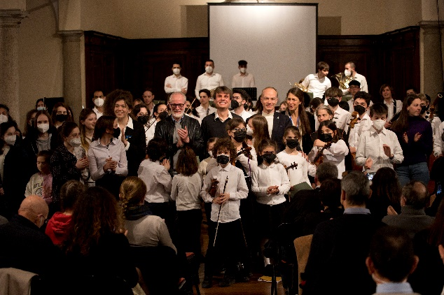
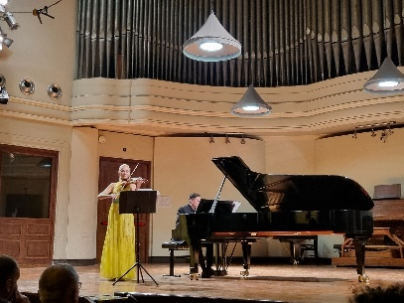
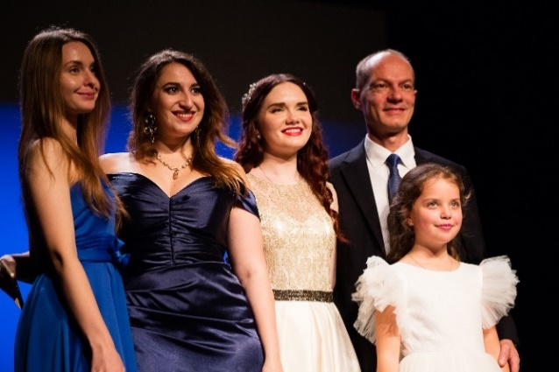
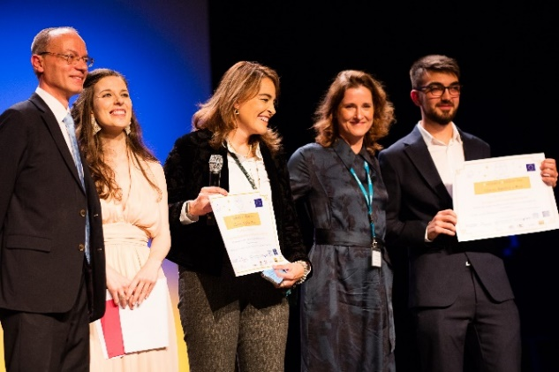
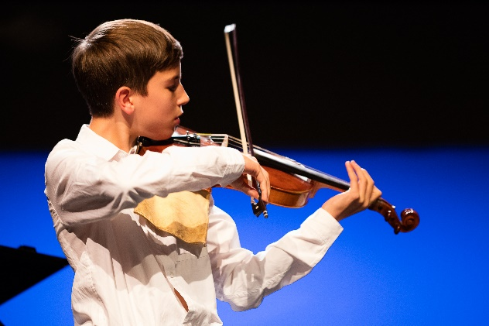
Leonardo 4 Children Events
Workshop
Award ceremony, Brussels, 20th October 2023 (BOZAR, tbc)
3 concerts (Italy, Spain, tbc)

Slide 31
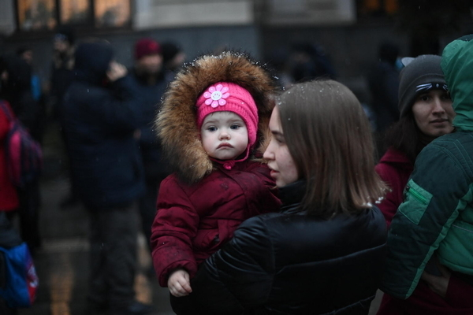
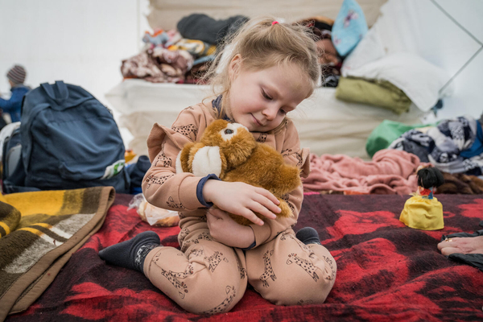
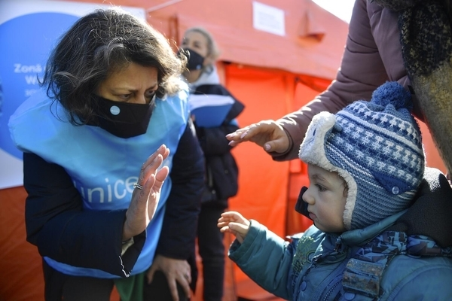
Leonardo 4 Children beneficiary project 2022-23
Support to Ukrainian refugees
Fauve Jacobs, UNICEF Belgium

Slide 32
Thank you and stay safe !
Social media: Facebook, Instagram, Linked-In, Twitter, Youtube
@carano4children
#Leonardo4Children
www.carano4children.org
Every child can be a Genius !

